Slide 1
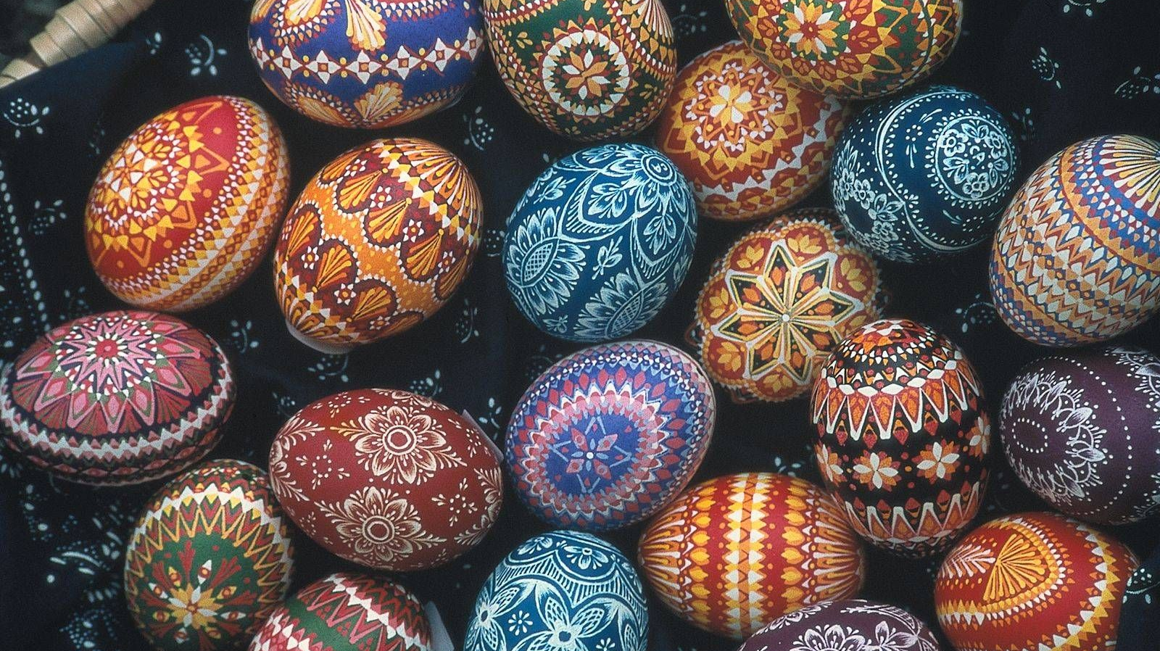
Easter eggs in Lithuania
Martyna, Mantas, Kamile

Slide 2
Easter

Slide 3
Popular ways how to decorate Easter eggs
Decorating with wax
Decorating with plants
Painting with natural inks

Slide 4
Decorating with wax

Slide 5
Decorating with plants

Slide 6
Painting with natural inks

