Slide 1
Ukrainian Folk Dances
Bernik Rika

Slide 2
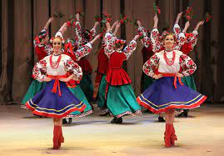
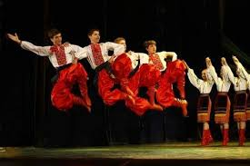
Ukrainian Folk Dances
Ukrainian dances - inflammatory and lyrical, unrestrained and slow, captivated the whole world. They clearly show the character, high and original culture of the Ukrainian people. Folk dances have become an integral part of the artistic life of Ukraine and world choreography. They continue their development on the modern stage.
Domestic dances, which include butterflies, hopaks, Cossacks, kolomyykas, hutsuls, quadrilles, polkas, are the basis of Ukrainian folk choreography. All known dance movements and their variants are the result of centuries-old folk practice in the field of dance art. Studying the technology of performing dance movements, you can see that they are based on one or another moment of the labor process or a human action.

Slide 3
Types of dances
Hopak is a traditional Ukrainian folk dance of Zaporozhian origin, performed solo or in groups at a fast pace with the use of jumps. Hopak arose in the life of the Zaporozhian army. Originally performed by men. Modern hopak is danced by men and women. Performing the dance allows improvisation (jumps, squats, rotations). Hopaks are solo, paired, group.
Kozachok is a Ukrainian fast-paced mass dance performed in pairs, in rows, and solo. This dance has a lot in common with hopak, but is lighter and more fun in nature.
Metelytsia is a mass dance of lively character and tempo, performed in pairs, with intertwining hands and fast whirling, reminiscent of a snowstorm (blizzard). The dance is accompanied by singing
Arkan is an ancient Ukrainian men's dance performed in a closed circle or semicircle with axes in hand. It is the main element of the rite of initiation of a young Hutsul into young men.

