Slide 1
The most popular types of dance in Ukraine

Slide 2
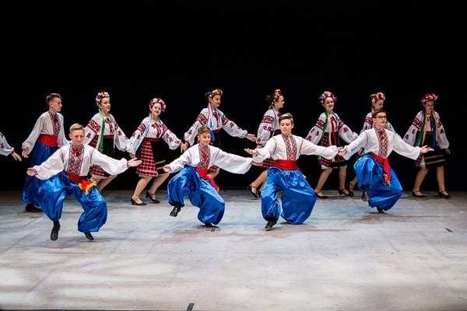
Hopak
The most popular is Hopak. This kind spread far from the border of Zaporizhzhya Sich and gained popularity among different sections of the population.
The movements are not simple, they require good physical training, but they are still performed with a smile and inspiration. Girls move with playing elements and gradually change their cheerful mood. Sometimes boys dance with Cossack sabers.
Sharovary is a "business card" of the Hopak. They are wide men's trousers, of red or blue colours that tie with a sack (belt).

Slide 3
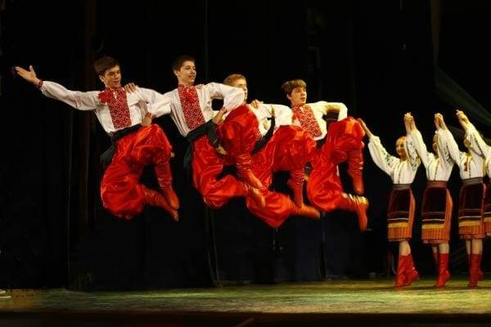
Cossack
The second most popular in Ukraine is the Cossack - named after the Cossacks. Performed in pairs without any extra tricks. It is characterized by ease, tenderness and lyricism. Improvisation and humorous moments are often used.

Slide 4
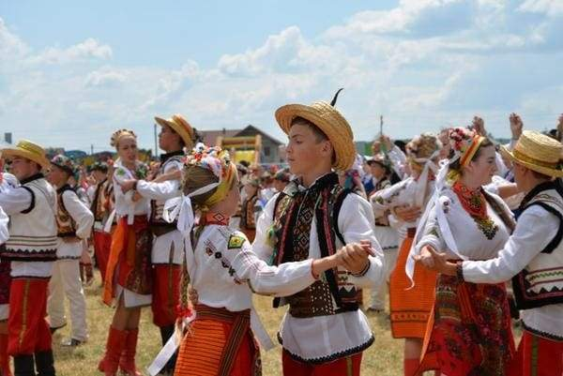
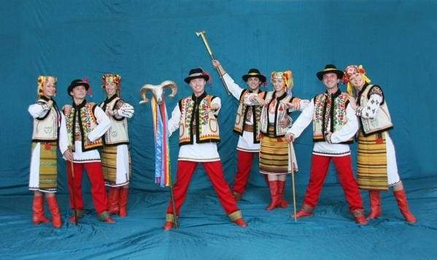
Kolomyika
Kolomyika - a kind of Carpathian highland dance. The name comes from short folk songs and after the city of Kolomyia, the largest city in the Pokuttia region. It is performed in pairs or more couples who dance in a circle.

